Slide 1
An integration data tool
for joinable tables
based on Apache Spark
By Javier de Jesús Flores Herrera
Thesis supervisor: Sergi Nadal Francesch
Thesis co-supervisor: Oscar Romero Moral

Slide 2

Let’s meet Laura
She is a data analyst
Interprets data and turns it into information
Works with datasets
Some taks: Inspect, collect, transform, validate, integrate

Slide 3
What’s a dataset?
Columns(attributes)
Rows (instances)
Dataset is a collection of data with a known schema

Slide 4
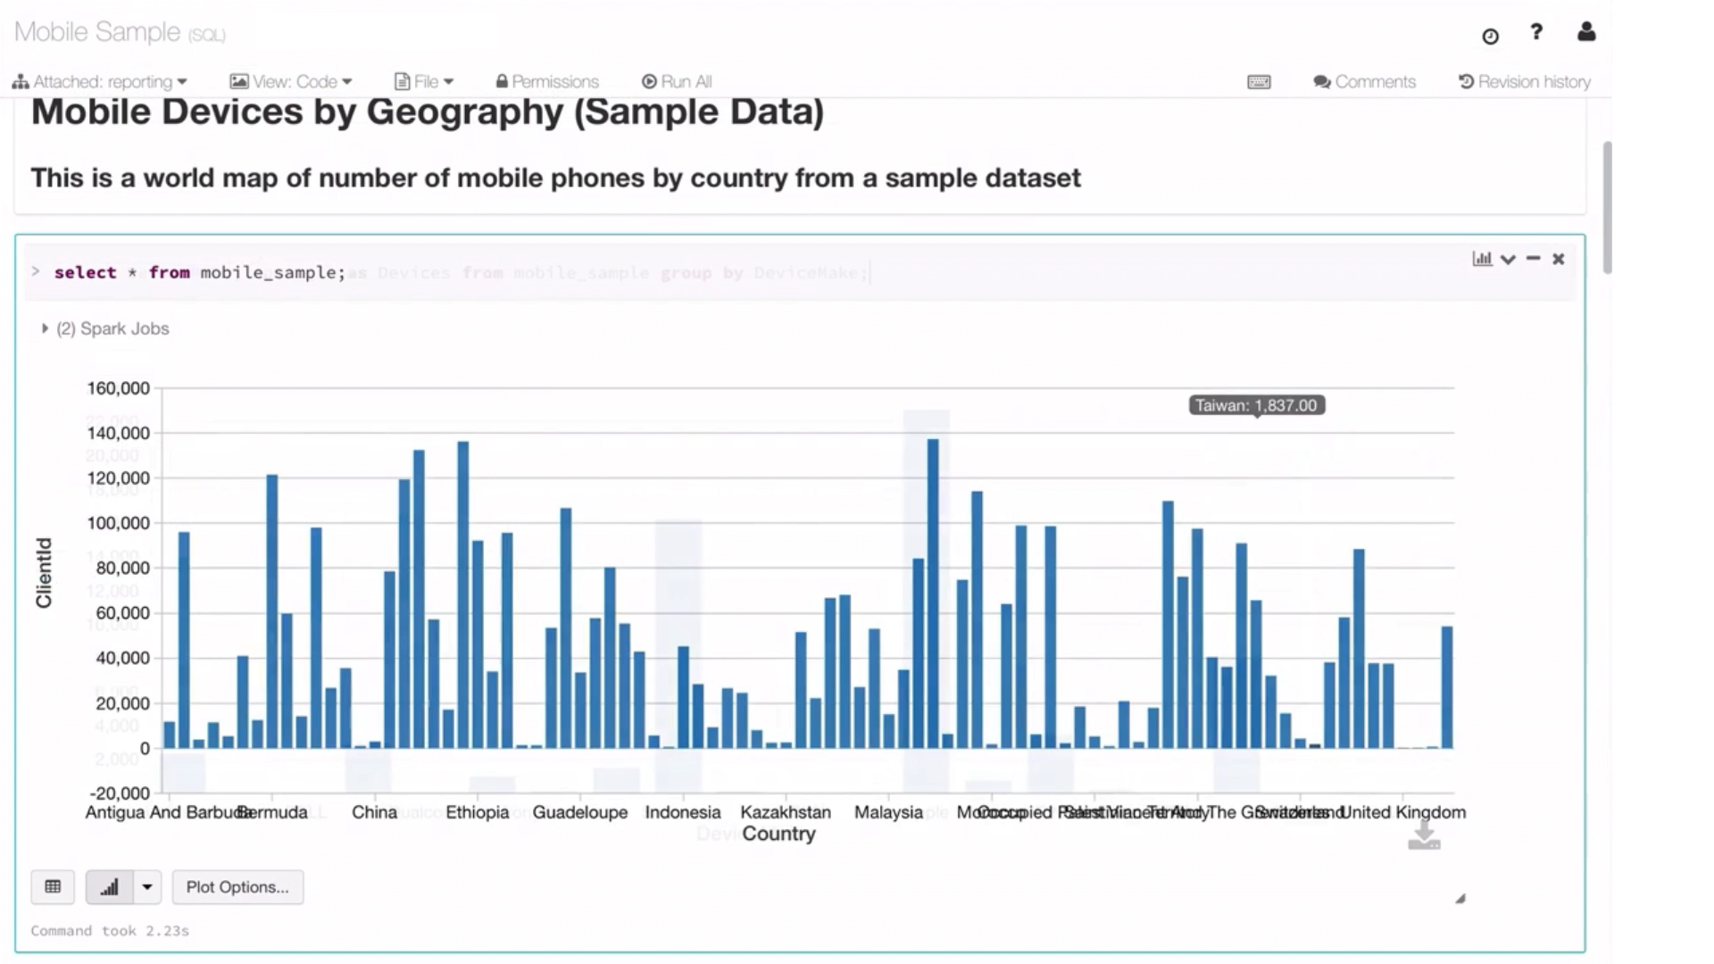
Interactive
Data pipeline
Storytelling
Interactivos.

Slide 5




Where Laura gets datasets? Data lakes…
Data Reusability
A lack of documentation
Raw data

Slide 6


Slide 7
State-of-the-art
Comparison-by-profile
Comparison-by-hash
Comparison-by-index
Estimate number of values shared between two attributes by using hash functions
Compare at data values minimizing read cost
Extract metadata for comparison

Slide 8
Our approach: concepts
Distinct set: It refers to the group of values of an attribute without considering duplicated
Joinable attributes: It is a pair of attributes that share common values and as a result allow to perform a join
Query attribute: It refers to an attribute provided by a data analyst to find other attributes from other datasets that may join with it
Query dataset. It refers to a dataset for which we are interested in finding other datasets to join with it
Candidate attribute: It is any attribute considered in the search to find joinable attributes
Candidate dataset: It is a pair of attributes formed by a query attribute and a candidate attribute

Slide 9
Our approach: quality joins
10
1500
10 000
100 000
100
20
55
20

Slide 10
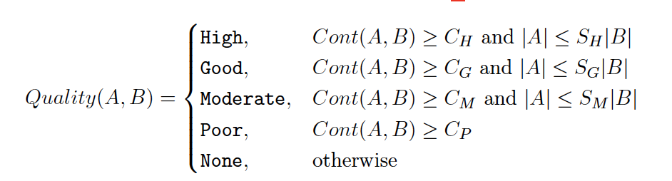
Our approach: quality joins
We define the emprirical values:
CH = 0:75; CG = 0:5; CM = 0:25; CP < CM.
SH = 4|A|; SG = 8.2|A|; SM = 12:5|A|.

Slide 11
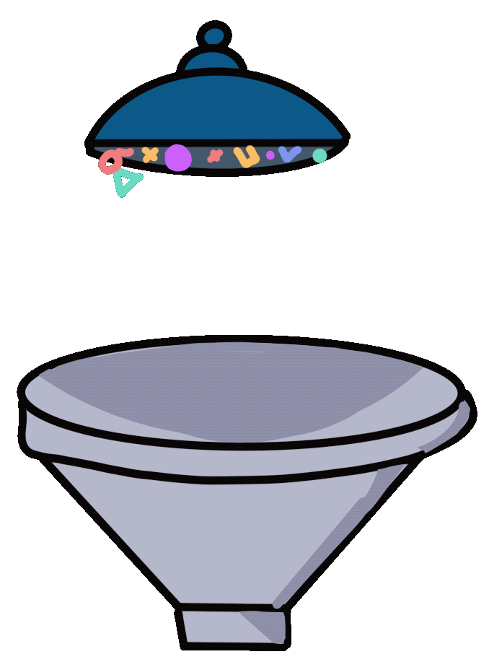
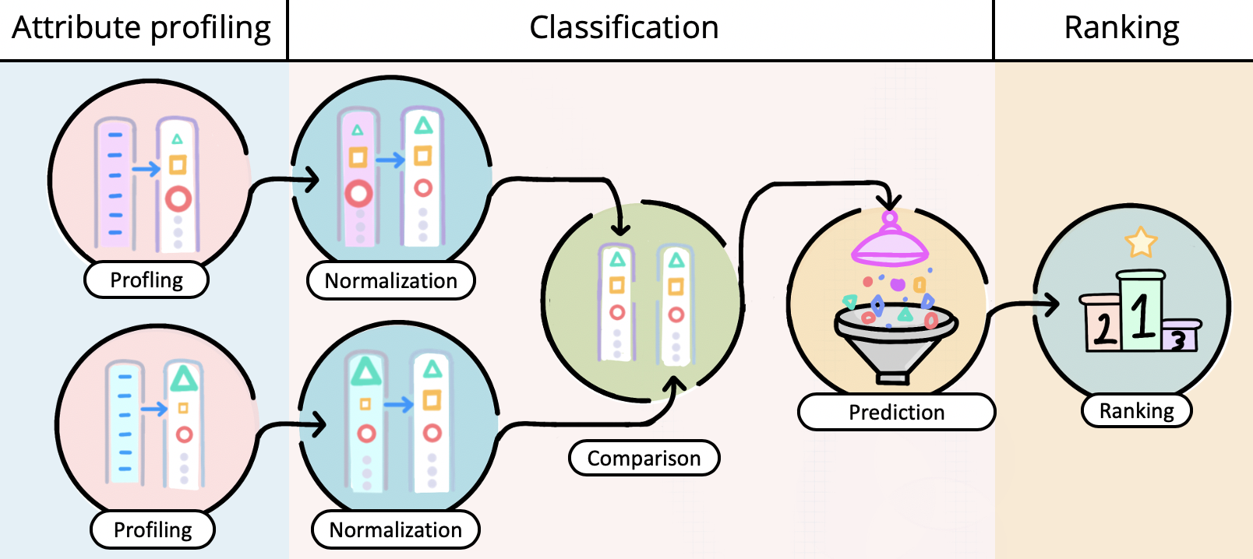
Approach: Stages
x
Profiling
Normalization
Comparison
Prediction
Ranking
Profiling
Normalization

Slide 12
Stage 1: Profiling
Country (Query attribute) | Airport name (Candidate attribute) | Nation (Candidate attribute) | Job (Candidate attribute) | Phone (Candidate attribute)
United States | Cancun International Airport | United States | Doctor | +34 653425180
Spain | NA | Spain | Engineering | +34 678919394
Mexico | NA | Mexico | Doctor | NA
France | Barcelona El prat | France | Doctor | +34 994892044
Canada | Chicago O’hare | United Kingdom | Doctor | +34 849300239

Slide 13
Approach: Stage 1
1) Remove duplicated values
Country (Query attribute) | Airport name (Candidate attribute) | Nation (Candidate attribute) | Job (Candidate attribute) | Phone (Candidate attribute)
United States | Cancun International Airport | United States | Doctor | +34 653425180
Spain | NA | Spain | Engineering | +34 678919394
Mexico | NA | Mexico |  | NA
France | Barcelona El prat | France |  | +34 994892044
Canada | Chicago O’hare | United Kingdom |  | +34 849300239

Slide 14
Country | Airport name | Nation | Job | Phone
United States | Cancun International Airport | United States | Doctor | +34 653425180
Spain | NA | Spain | Engineering | +34 678919394
Mexico | NA | Mexico |  | NA
France | Barcelona El prat | France |  | +34 994892044
Canada | Chicago O’hare | United Kingdom |  | +34 849300239
Stage 1
1) Start profiling
 | Country (Query attr) | Airport name (Candidate attr) | Nation (Candidate attr) | Job (Candidate attr) | Phone (Candidate attr)
Cardinality | 5 | 3 | 5 | 2 | 4
Incompleteness | 0 | 0.4 | 0 | 0 | 0.2
% alphabetic | 1 | 0.66 | 1 | 1 | 0
% numeric | 0 | 0 | 0 | 0 | 1
Data Type | Alphabetic | Alphabetic | Alphabetic | Alphabetic | Numeric
Shortest string | 5 | 14 | 5 | 6 | 13
Longest string | 13 | 28 | 14 | 11 | 13
% of username | 0.8 | 0 | 0.6 | 0.5 | 0
BestContainment | - | - | - | - | -
FlippedContainment | - | - | - | - | -

Slide 15
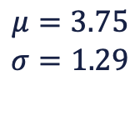
Stage 2: Normalization
 | Country (Query attr) | Airport name (Candidate attr) | Nation (Candidate attr) | Job (Candidate attr)
Cardinality | 0.96 | -0.58 | 0.96 | -1.35
Incompleteness | 0 | 0.4 | 0 | 0
% alphabetic | 1 | 0.66 | 1 | 1
% numeric | 0 | 0 | 0 | 0
Shortest string | -1.22 | 1.11 | -1.22 | -0.95
Longest string | -0.52 | 1.71 | -0.37 | -0.81
% of username | 0.8 | 0 | 0.6 | 0.5
BestContainment | - | - | - | -
FlippedContainment | - | - | - | -
$$μ=3.75$$
$$σ=1.29$$

Slide 16
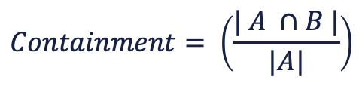
Stage 3: Comparison
1) Create pairs and compute distance
 | (Country, Airport name) | (Country, Nation) | (Country, Job)
Cardinality | 1.54 | 0 | -0.39
Incompleteness | -0.4 | 0 | 0
% alphabetic | 0.34 | 0 | 0
% numeric | 0 | 0 | 0
Shortest string | -2.33 | 0 | -0.27
Longest string | -2.23 | -0.15 | 0.29
% of username | 0.8 | 0.2 | 0.1
BestContainment | 0.6 | 1 | 0.4
FlippedContainment | 0.6 | 1 | 0.4
$$Containment= \left(\frac{| A ∩B |}{|A|}\right)$$

Slide 17
Stage 4: Classification
We trained 5 Random Forest models using a One-vs-the-Rest strategy.
Model class 0
Model class 0
Model class 0
Model class 0
Model class 0

Slide 18
Stage 4: Classification
Model class 0
Model class 0
Model class 0
Model class 0
Model class 0
Positive class
Class 0: 9836
Positive class
Class 0: 9836
Positive class
Class 0: 9836
Positive class
Class 0: 9836
Positive class
Class 0: 9836
Negative class
Class 1: 9011
Class 2: 249
Class 3: 226
Class 4: 350
Negative class
Class 1: 9011
Class 2: 249
Class 3: 226
Class 4: 350
Negative class
Class 1: 9011
Class 2: 249
Class 3: 226
Class 4: 350
Negative class
Class 1: 9011
Class 2: 249
Class 3: 226
Class 4: 350
Negative class
Class 1: 9011
Class 2: 249
Class 3: 226
Class 4: 350

Slide 19
Stage 4: Classification
Model class 0
Model class 0
Model class 0
Model class 0
Model class 0
 | Model Class 0 | Model Class 1 | Model Class 2 | Model Class 3 | Model Class 4
(Country, ariport name) | 0.7 | 0.71 | 0.3 | 0.1 | 0.1
(Country, Nation) | 0 | 0.4 | 0.55 | 0.77 | 0.94
(Country, Job) | 0.67 | 0.5 | 0.4 | 0.2 | 0.2

Slide 20
Stage 5: Ranking
Rules:
If confidence level for Class 0 > 50% and
higher confidence from Class 1,2,3,4: downgrade class for the next inferior class
If confidence level is low <= 50%, if higher probability is from a joinable class but confidence level from Class 0 is close to it. We downgrade the class . Empirical threshold use of 0.1
 | Class assigned | Rank
(Country, ariport name) | Class 0 | NA
(Country, Nation) | Class 4 | 1
(Country, Job) | Class 0 | NA

Slide 21





Validation: Experiment 1
The model identifies join attributes for new datasets that belong to the same domain of those datasets used in the training
Movies
624 joinable attributes
World university ranks
68 joinable attributes
Minimum Wage US.
172 joinable attributes
Billboard lyrics 1964 -2015
454 joinable attributes
Tech acquisitions.
258 joinable attributes

Slide 22
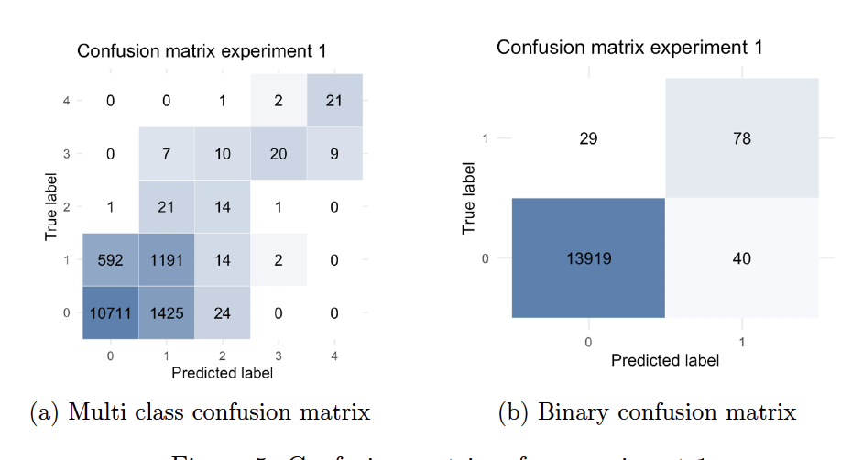
Experiment 1: Results

Slide 23




Validation: Experiment 2
The model identifies joinable attributes for unseen topics
Chemical structures
5 datasets
Parks from Vancouver
9 datasets
Carcinogenesis
6 datasets
Videogrames
2 datasets
Toxicology
4 datasets

Slide 24
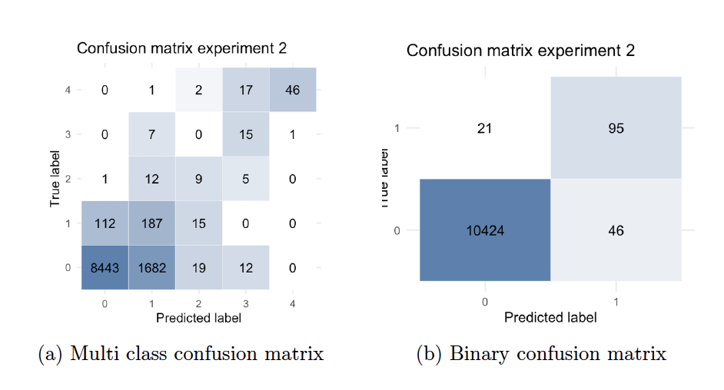
Experiment 2: Results

Slide 25
Demo

